Slide 1
Synnduit @CCSD
Calgary Catholic School District’s Use of the Synnduit Platform

Slide 2
What Is Synnduit?
“Synnduit is an open-source enterprise integration platform designed to enable long-term application coexistence. Developed in .NET, it’s built to work with any enterprise system, and it gives business analysts and developers enormous flexibility and extremely granular control.”

Slide 3
A Brief History of Synnduit
A number of similar projects led to “patterns”
Started building a framework with, initially, no real-world opportunity to apply it
It’s turned out to be a great fit for the Calgary Catholic School District’s portal integration project
A great opportunity to finish and release to open source
No cost to CCSD – a win-win situation!

Slide 4
Synnduit Is Flexible
Does as much as possible “out-of-the-box”...
… but treats developers as first-class citizens!
Features a .NET framework
All default behavior can be overridden

Slide 5
Synnduit Embraces Granularity
Integration is hard…
… and the devil is in the details!
Provides extraordinary visibility of integration activity…
…down to the level of an individual value change
Blends integration with version control…
…when the unexpected happens, Synnduit can help!
“ETL Meets Version Control”

Slide 6
Synnduit Is Easy
Synnduit is an engine!
You implement connections to your external systems
Source Systems
Destination Systems
You implement custom logic as necessary (e.g., duplicate detection)
You provide “data snapshots”, Synnduit detects and processes the “delta”

Slide 7
Free and Open-Source
Permissive License (Apache v2.0)
Risk free…
…treat (virtually) as your own source code if so inclined!
No lock-in
Contributions welcome – everyone can benefit

Slide 8
Why Synnduit?
Continuous, long-term data migrations (integration vs. import)
Unified, pattern-based approach to integration
Duplicate detection, merging, change tracking, logging
Can interface in many ways, including direct database access and APIs
High performance, high reliability

Slide 9
Synnduit @CSSD: Case Studies
Portal Integration, SharePoint Online Integration, Reporting Integration, and more…

Slide 10
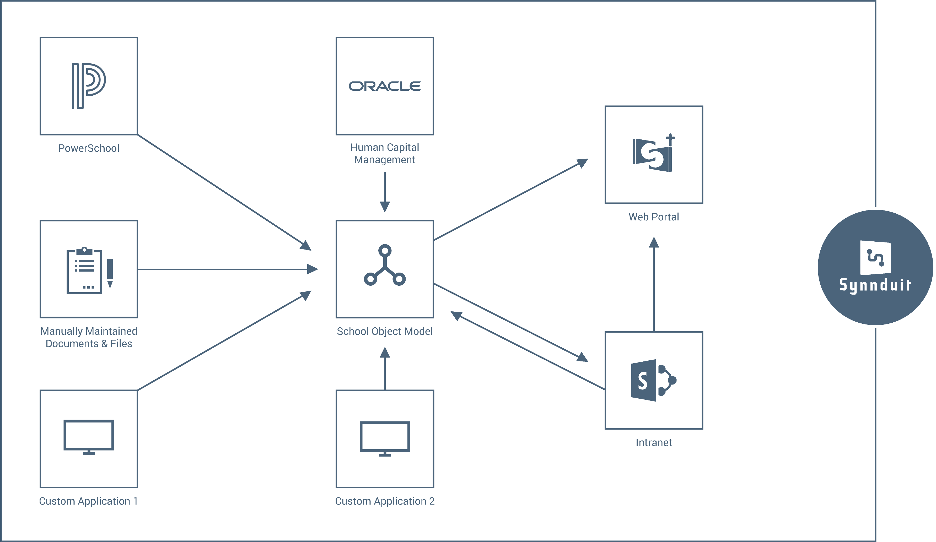
CCSD Integration Architecture

Slide 11
Portal Integration
Data exists in various existing systems, including:
PeopleSoft (HR)
PowerSchool
SSIS (custom; has been replaced with a direct PowerSchool link)
Various documents and more…
SchoolBundle is not intended to replace existing apps
One-off migrations aren’t sufficient: Live data keeps changing
Data changes in multiple systems: Merging is required

Slide 12
SharePoint (Intranet) Integration
Several “Team Site Templates” defined:
School Site
Department Site (HR, Document Services, Communications, etc.)
Functional Site (Principals, DLT, etc.)
Actual, out-of-the-box “SharePoint templates” not usable
Templates keep evolving, and existing sites need to reflect these changes
Security-related information exists in HR
Automatic updates of SharePoint security records saves a lot of manual labor
Much information in SOM editable via Supplemental Data Manager

Slide 13
Reporting Integration
Security information in School Object Model too complex for use in interactive reporting
Preprocessed and exported into a standalone “reporting” database (ETL style)
Benefits less obvious than in the previous two cases, as “classic ETL” (i.e., replacing all data every single time) would be feasible
Important benefits do still exist, though…
Improved Performance
“Uninterrupted” Operation
Version Control (History)

Slide 14
CCSD Integration Architecture

Slide 15
Benefits from Synnduit
Always up-to-date data in SchoolBundle (portal, as well as intranet)
Substantial reduction in custom code volume (~75%)
Fewer bugs, less error prone
History tracking & version control features
Facilitates support & troubleshooting
Very little maintenance required

